Slide 1







Personal Finance &
Budget Management System
A Normalized Relational Database Solution for Real-Time Expense Tracking, Automated Budget Control, & Financial Analytics
S. Yaswanth Kumar
Veda Praneeth
Nikil
M. Jashwanth
Ruthvik
2510030264
2510030069
2510030358
2510030196
2510030348

Slide 2

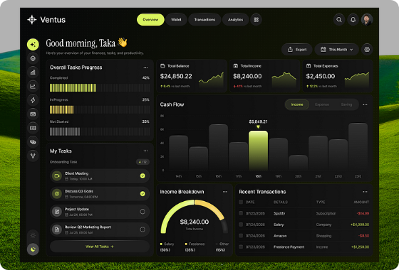
Problem Statement
Fragmented Records: Manual tracking across cash, bank accounts, and credit cards leads to unorganized history.
Lack of Active Budget Control: Users overspend without real-time notifications before monthly limits are hit.
Data Redundancy & Errors: Traditional spreadsheets cause inconsistent records and duplicate entry risks.
Slow Complex Queries: Non-relational setups lack indexing and views, making analytical queries slow.

Slide 3






Project Objectives
3NF Schema
Automated Triggers
Aggregated Views
ACID Compliance
Design a clean relational database schema in Third Normal Form (3NF) to completely eliminate insertion, update, and deletion anomalies.
Implement active SQL BEFORE INSERT and AFTER UPDATE triggers to update running account balances and fire budget alerts.
Formulate optimized SQL views and stored procedures for instant monthly income/expense breakdowns and analytics.
Ensure fail-safe multi-account fund transfers and ledger posting with full transactional integrity and atomic rollbacks.

Slide 4





Key System Novelties
DB-Enforced Budgeting
Atomic Fund Transfers
Sub-20ms SQL Views
Zero-Redundancy 3NF
Shifting budget limit enforcement directly to native BEFORE INSERT triggers, eliminating application-layer race conditions and overspending latency.
Multi-account transfers executed via ACID-compliant stored procedures. Guarantees 100% data consistency with automated state rollback on failure.
Pre-calculated analytical views (vw_monthly_summary) paired with B-Tree composite indexes offload complex aggregations to the DB engine.
Strict Third Normal Form architecture enforcing referential integrity across users, ledgers, categories, and budgets at the raw schema level.

Slide 5







Technology Stack
Database Tier
Backend Layer
Frontend Layer
Security & Tools
MySQL / PostgreSQL with B-Tree Indexes, Foreign Keys, Stored Procedures, Aggregated Views, & Active Triggers.
Python (Flask / FastAPI) with RESTful APIs, Connection Pooling, SQLAlchemy ORM, and Data Validation.
React.js + Tailwind CSS providing an Interactive Analytics Dashboard, Chart.js Visualizations, and Real-Time Feeds.
Bcrypt & JWT Auth with Password Hashing, Role-Based Access Control (RBAC), and Git/GitHub Versioning.

Slide 6

Expected Outcomes
100%
<20ms
3NF
Real-Time
ACID Compliance
Query Speed
Zero Redundancy
Automated Alerts
Guaranteed data consistency during multi-table transaction transfers.
Rapid execution times via B-Tree indexing on primary & foreign keys.
Fully normalized relational schema eliminating duplicate records.
Instant DB-level alerts triggered when category limits hit 80% & 100%.

Slide 7
Project Modules
Module Name | Database Tables Involved | Key Features & SQL Functionality
User & Auth | Users, Sessions | Secure signup, Bcrypt hashed passwords, JWT token authentication.
Account Management | Accounts, Account_Types | Tracks Savings, Checking, & Credit cards with active balance triggers.
Transaction Engine | Transactions, Categories | Income/expense logging, category tagging, date-indexed queries.
Budget & Alert System | Budgets, Alert_Logs | Monthly spending limit evaluation via BEFORE INSERT triggers.
Analytics & Reporting | vw_monthly_summary (SQL View) | Aggregated monthly breakdowns and category spending ratios.

Slide 8




Project Plan & Timeline
Schema & ER Design
DDL/DML & Scripts
API & UI Integration
Testing & Demo
Requirements gathering, mapping ER diagrams, and defining 3NF normalization constraints.
Writing table creation scripts, foreign keys, stored procedures, and automated triggers.
RESTful API endpoints, ORM integration layer, and building interactive React dashboard.
Transaction ACID stress tests, benchmarking index query speeds, and final presentation.

